Slide 1
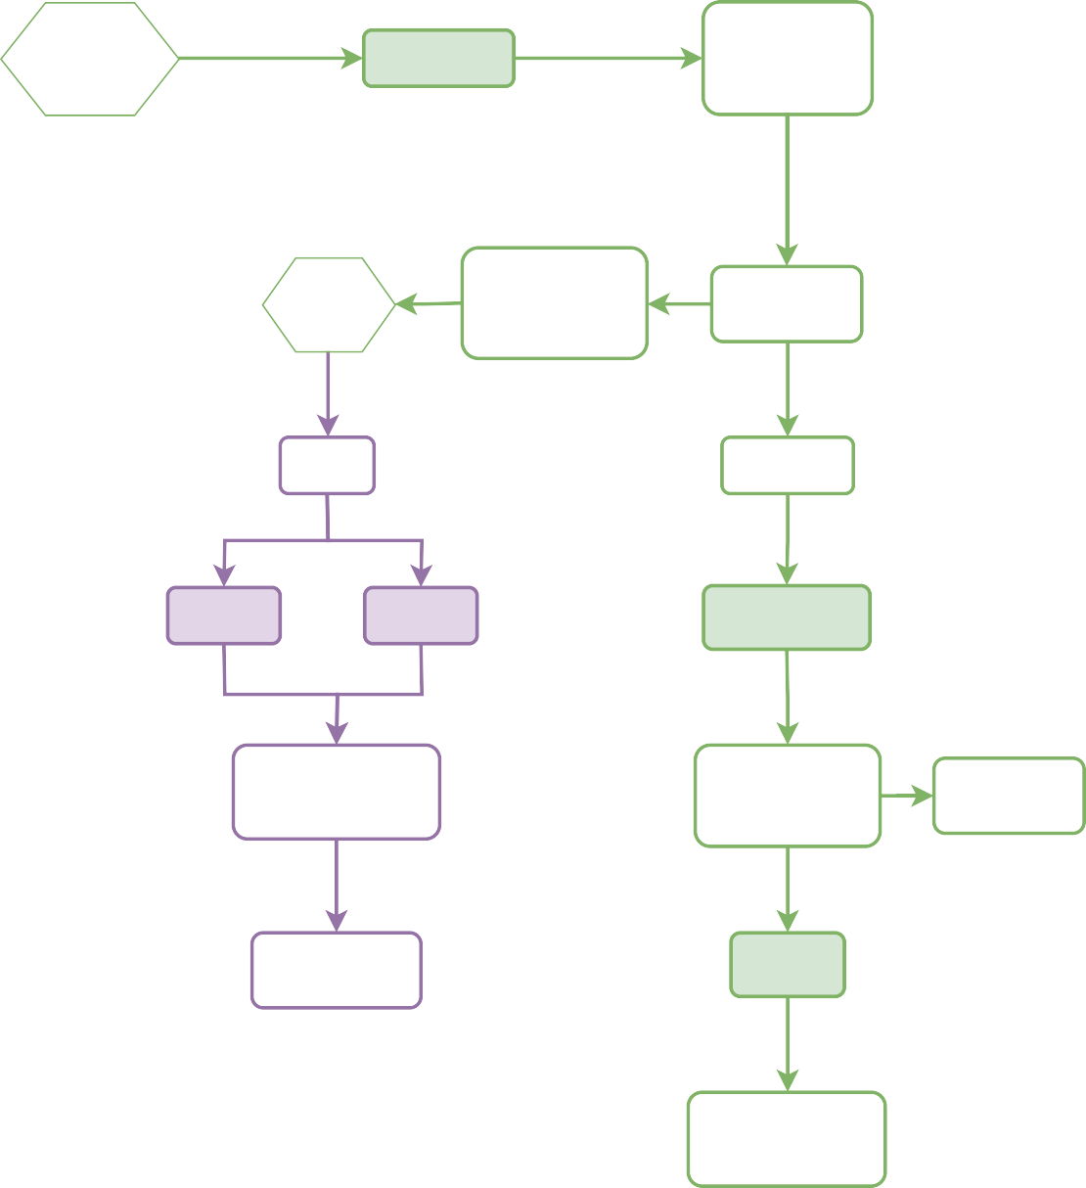
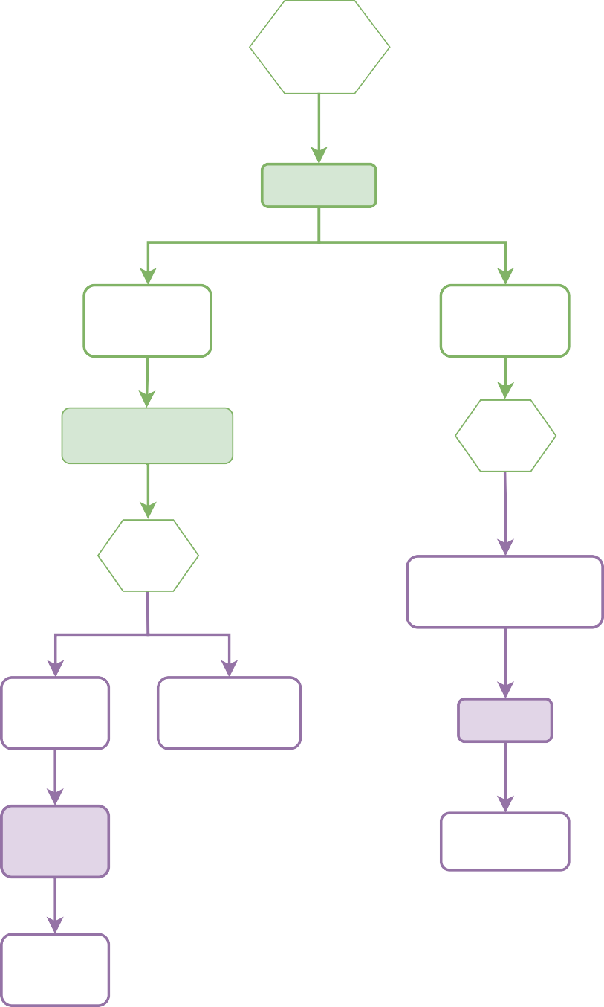
MSK-SPECTRUM Tissue Collection Workﬂow
(JL 1/16/20)
Clinic
Key:
Occurs before surgery
Screen clinic
Occurs day of surgery
Occurs after day of surgery
Standard of Care
Consent patient on study and collect pre-op blood in clinic
Surgery scheduled and technician notiﬁed
Flow and IGO appointment booked
Flow and IGO appointment booked
OR sample collection
6-8 fresh tissue samples to
technician
GYN Lab
Single Cell
Dissociation
Storage of unsorted single cell suspensions
Pathology Department
Stored in GYN Lab
6-8 matched tissue samples to PPBC
Stored in GYN Lab
Storage of sorted single cell suspensions
Flow Cytometry
IMPACT
Testing
PPBC
DLP
scRNA
Flow Cytometry
Formalin (FFPE)
Frozen Tissue (-80c)
BCCRC
IGO
GYN Lab
DLP
Molecular Cytology
Stored in Biobank
Spotting/Library Prep
10X cfDNA and Library Prep
Store Sorted scs
BCCRC
IGO
Stored in GYN Lab
Text
Sequencing
IGO
Spotting/Library Prep
Microdissection, DNA/RNA extractions
H&E generation
mpIF, IHC,
slide generation
IGO
scRNA Sequencing
Sequencing
Pathology Department
Bulk WGS
Path Review (Soslow)

